Slide 1
Global to Local: Comparing Clean Energy and Emissions Reduction Policies from the EU and Germany to the Southeastern U.S.
Rebekah de la Mora, Justin Lindemann, and Brian Lips
Policy & Markets Team
NC Clean Energy Technology Center
NCSU Global Training Initiative Workshop
August 26th, 2025

Slide 2
Agenda
Intro
Comparing Clean Energy and Emissions Reduction Policies: The EU, U.S., Germany, and the Southeastern U.S.
  Global Overview
  European Union Policies
  Germany Policies
  United States Policies
  Southeastern U.S. Policies
Breakout Group Discussions
Closing

Slide 3

Our Mission
The N.C. Clean Energy Technology Center, at N.C. State University, advances a sustainable energy economy by educating, demonstrating and providing support for clean energy technologies, practices, and policies.
For over 35 years, the Center has worked closely with partners in government, industry, academia and the non-profit community.

Slide 4
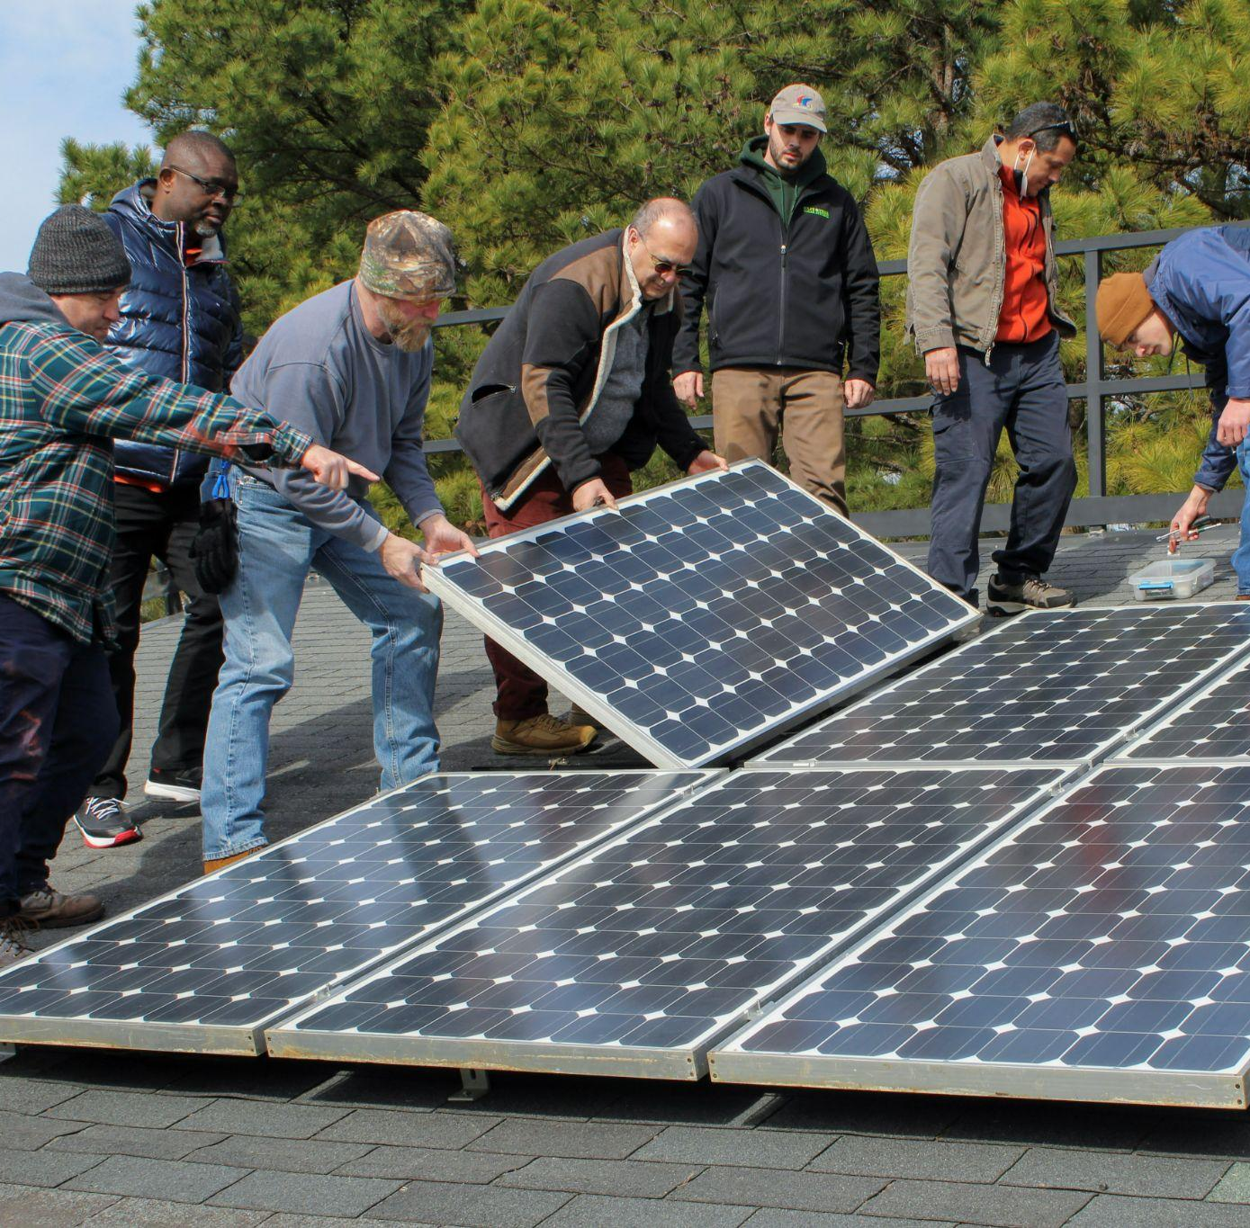
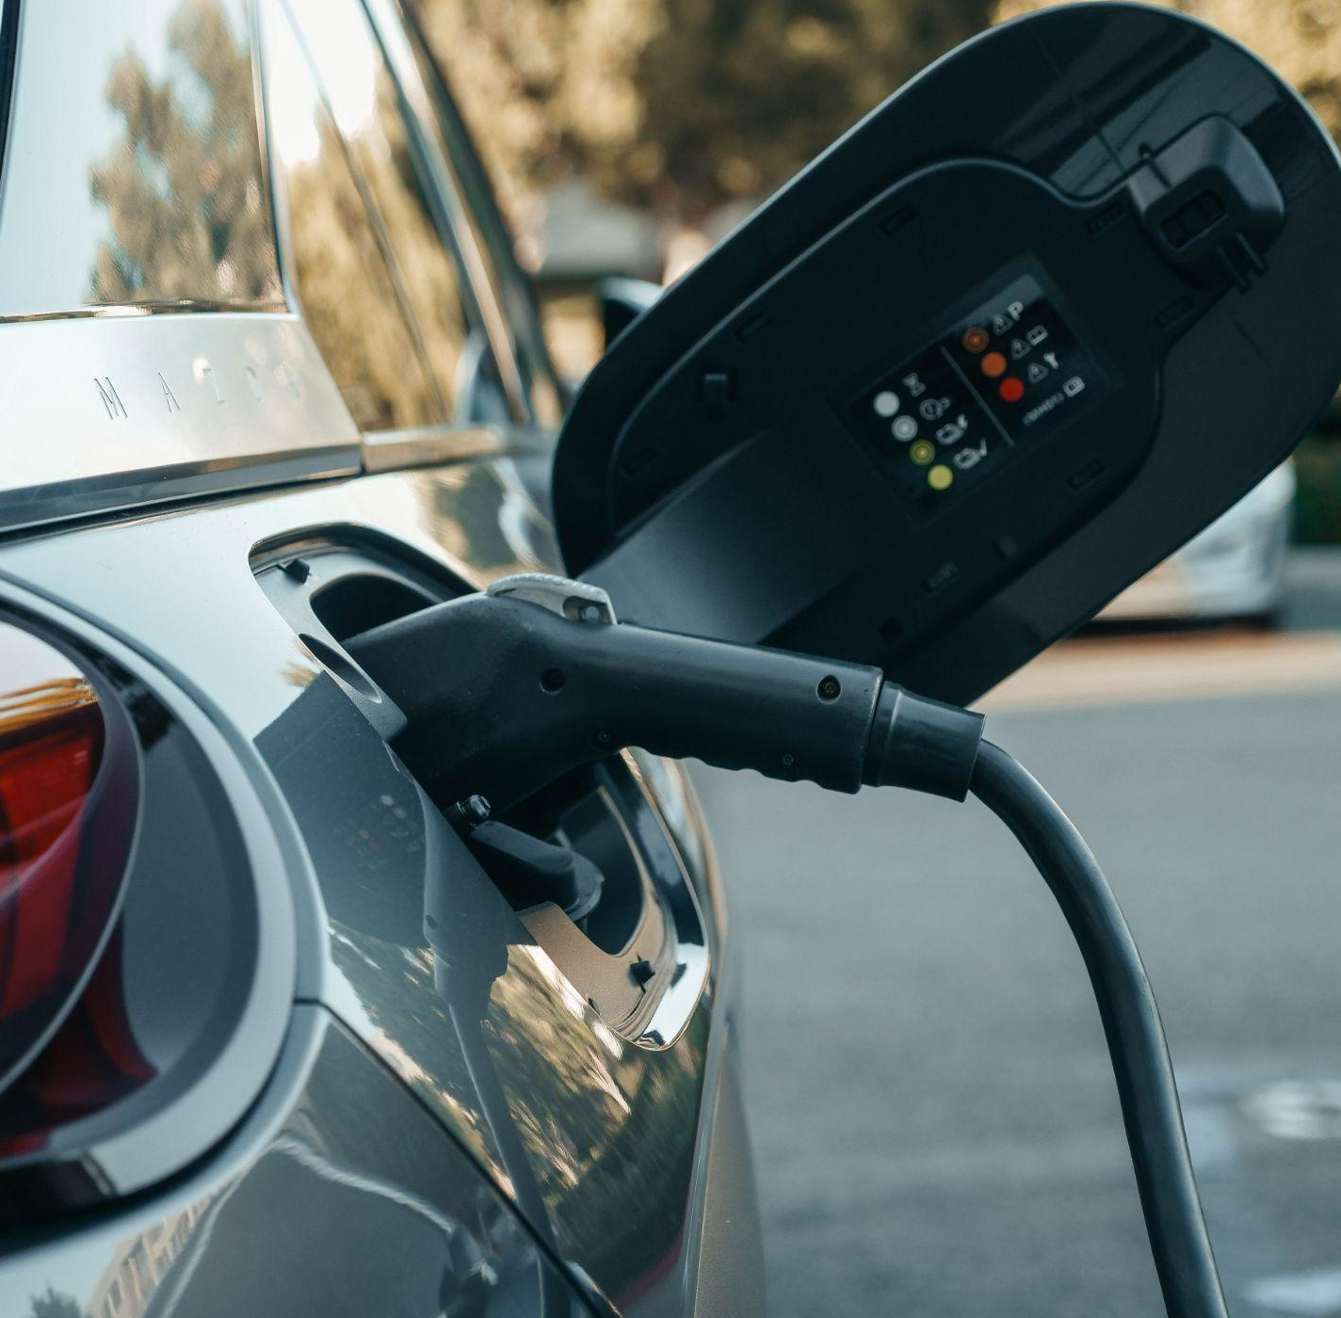
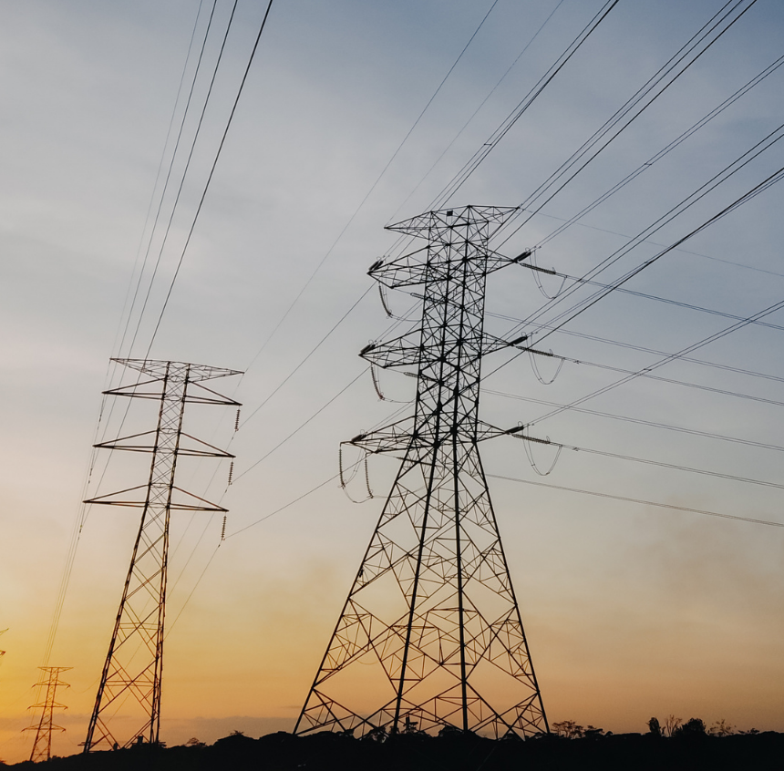

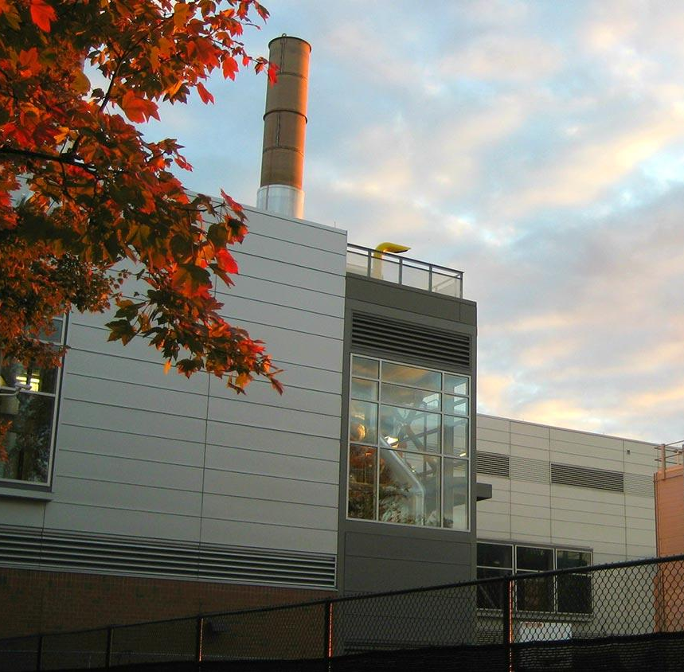
Our Work
Energy Policy
Clean Energy Training
Clean Transportation
Clean Power & Industrial Efficiency
Renewable Energy

Slide 5
Icebreaker
What do you think the government’s job should be in helping a country shift to clean energy and reduce emissions?

Slide 6
Global

Slide 7
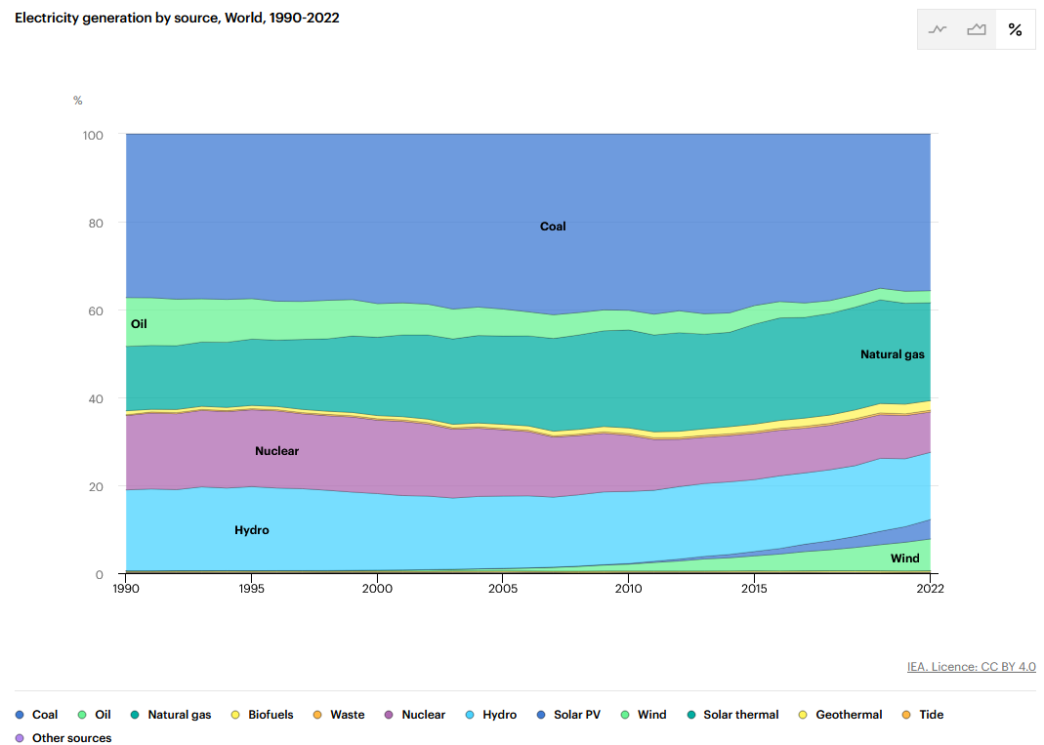
Electricity generation by source
World, 1990-2022
Notes:
Additional Source: https://www.iea.org/data-and-statistics/data-tools/energy-statistics-data-browser?country=WORLD&fuel=Energy%20supply&indicator=ElecGenByFuel

Slide 8
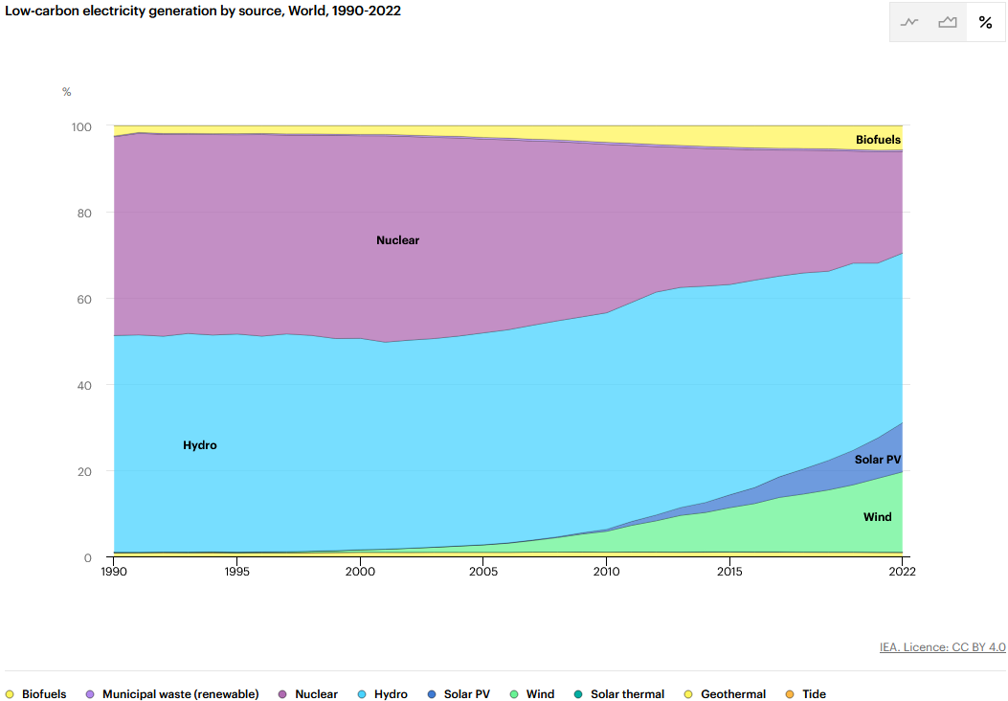
Low-carbon electricity generation by source
World, 1990-2022
Notes:
Additional Source: https://www.iea.org/data-and-statistics/data-tools/energy-statistics-data-browser?country=WORLD&fuel=Energy%20supply&indicator=ElecGenByFuelLC

Slide 9
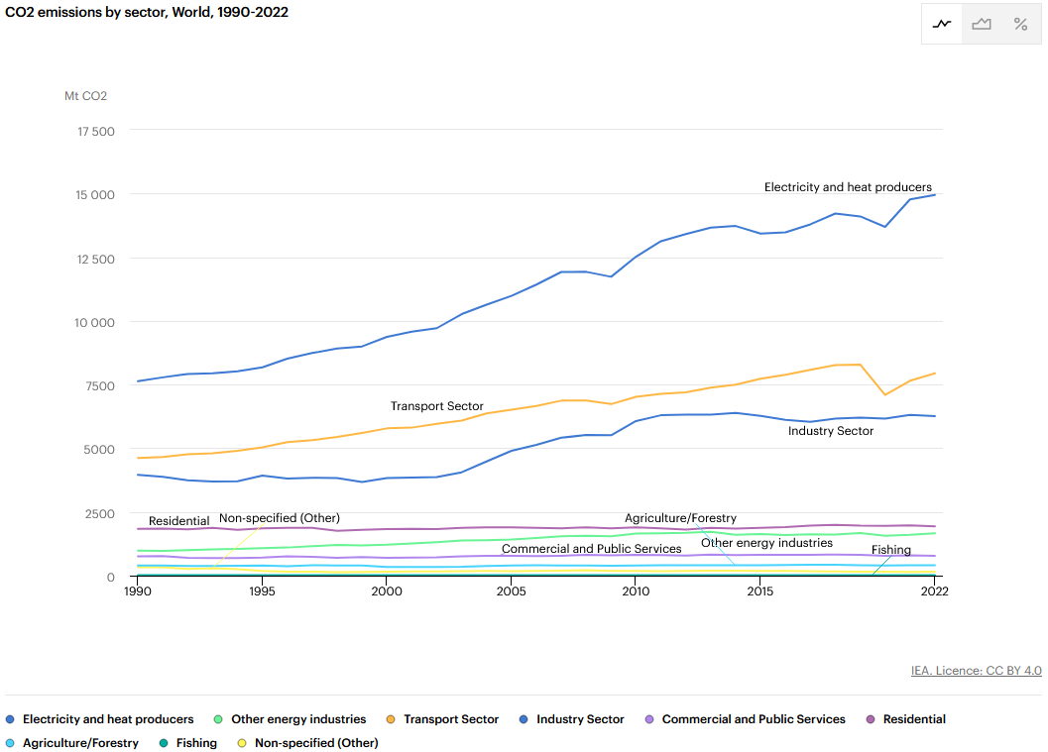
CO2 emissions by sector
World, 1990-2022
Coal: 74%
Gas: 21%
Oil: 5%
Notes:
Additional Source: https://www.iea.org/data-and-statistics/data-tools/energy-statistics-data-browser?country=WORLD&fuel=Energy%20supply&indicator=ElecGenByFuelLC

Slide 10

UN Framework Convention on Climate Change (1992)
Goal: “to achieve […] the stabilization of greenhouse gas concentrations in the atmosphere at a level that would prevent dangerous anthropogenic interference with the climate system”
Additional commitments for developed countries
Notes:
Additional Source: https://unfccc.int/process-and-meetings/what-is-the-united-nations-framework-convention-on-climate-change

Slide 11
Kyoto Protocol (1997)
5% reduction compared to 1990 levels over 2008-2012
  Doha amendment: 18% reduction compared to 1990 levels over 2013-2020
Focuses specifically on developed countries
  “common but differentiated responsibility and respective capabilities”
Notes:
Additional Source: https://unfccc.int/kyoto_protocol

Slide 12
Paris Agreement (2015)
Limit global temperature increase to less than 2C below pre-industrial levels
  Ideally 1.5C
Nationally Determined Contributions
European Union | United States
2030: 55% below 1990 levels for economy-wide GHGs 2050: Climate Neutral | 2035: 61% - 66% below 2005 levels for economy-wide GHGs 2050: Net Zero for all GHGs
Notes:
Additional Sources:
https://unfccc.int/process-and-meetings/the-paris-agreement
https://unfccc.int/process-and-meetings/the-paris-agreement/nationally-determined-contributions-ndcs
https://unfccc.int/sites/default/files/NDC/2023-10/ES-2023-10-17%20EU%20submission%20NDC%20update.pdf
https://unfccc.int/sites/default/files/2024-12/United%20States%202035%20NDC.pdf

Slide 13
European Union

Slide 14
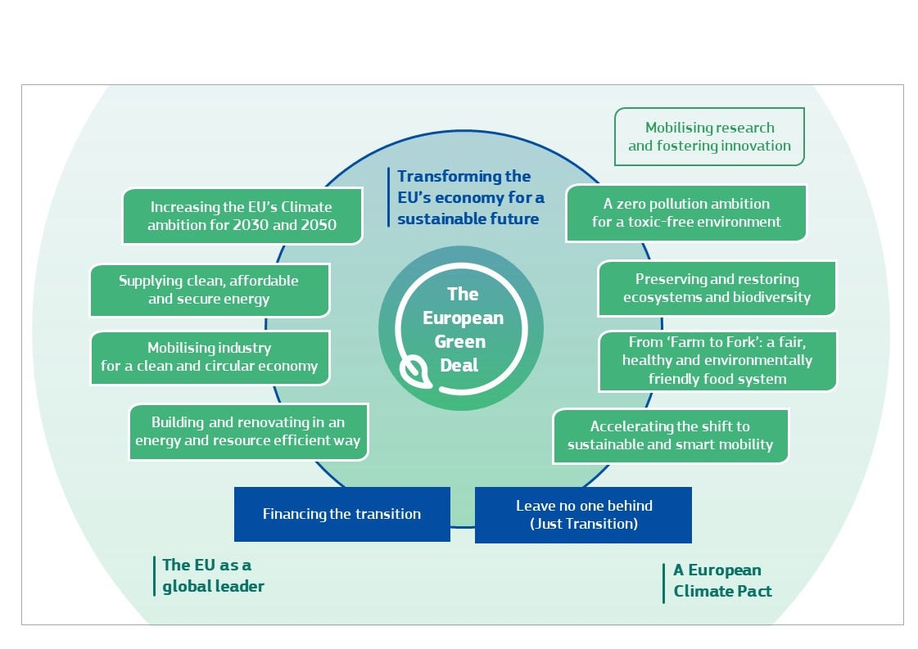
European Green Deal (2020)
Notes:
Additional Source: https://eur-lex.europa.eu/legal-content/EN/TXT/HTML/?uri=CELEX:52019DC0640

Slide 15
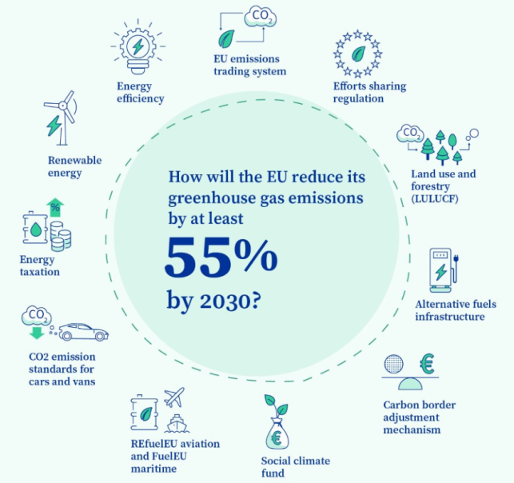
Fit for 55 (2023)
Notes:
Additional Source: https://build-up.ec.europa.eu/en/resources-and-tools/links/fit-55

Slide 16
Renewable Energy Directive III (2023)
EU-wide binding target of 42.5% renewable energy by 2030
  Non-binding goal of 45%
  24.6% renewable as of 2023
Sub-targets for different economic sectors
Historical focus on biofuels
Notes:
Additional Source: https://energy.ec.europa.eu/topics/renewable-energy/renewable-energy-directive-targets-and-rules/renewable-energy-directive_en

Slide 17
Carbon Pricing
Emissions Trading System (2005)
  imposed on EU emissions from electricity and heat generation, industrial manufacturing and aviation
Carbon Border Adjustment Mechanism (2023)
  imposed on carbon-intensive goods imported into the EU
  Starts 2026
Notes:
Additional Sources:
https://climate.ec.europa.eu/eu-action/carbon-markets/eu-emissions-trading-system-eu-ets_en
https://taxation-customs.ec.europa.eu/carbon-border-adjustment-mechanism_en

Slide 18
Germany

Slide 19
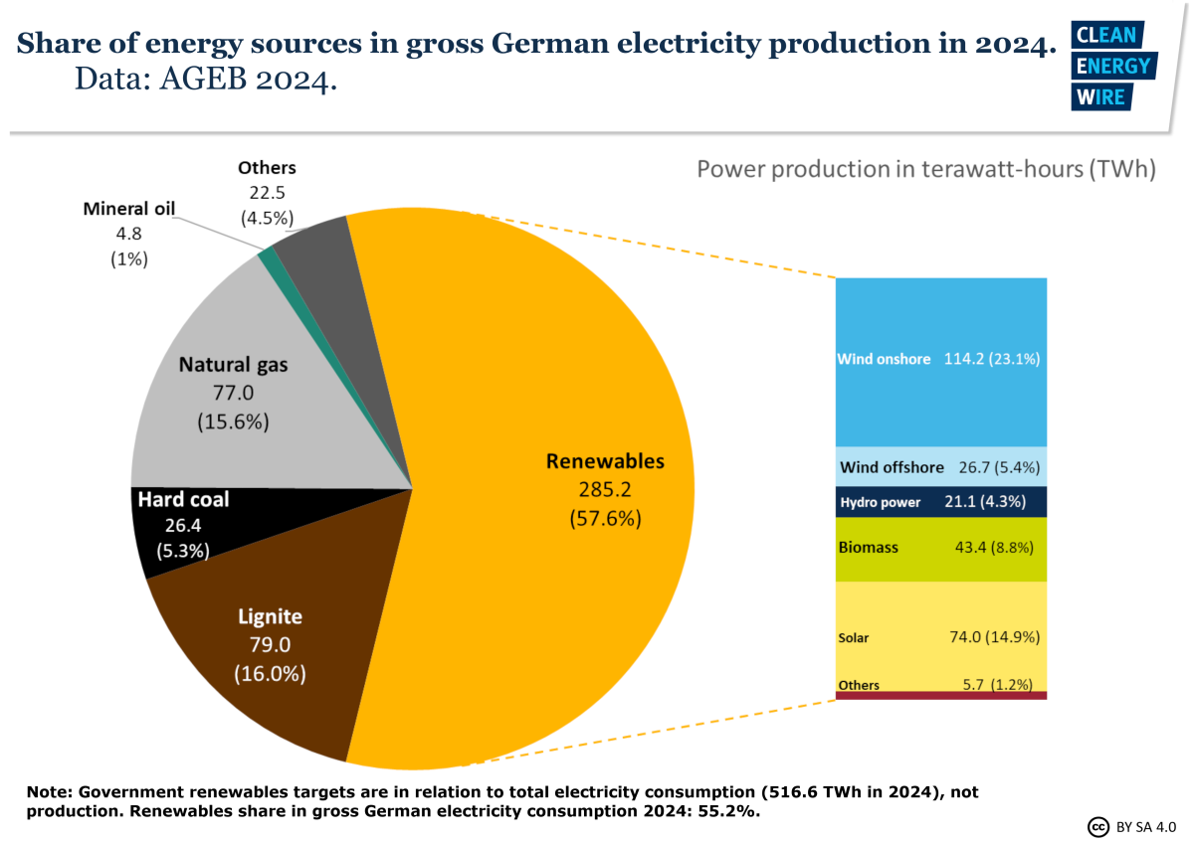
Climate Change Act (Klimaschutzgesetz; KSG)
Net-zero by 2045
Negative emissions after 2050
Allows climate targets to be increased to match international and EU targets
Source: https://www.cleanenergywire.org/factsheets/germanys-energy-consumption-and-power-mix-charts

Slide 20
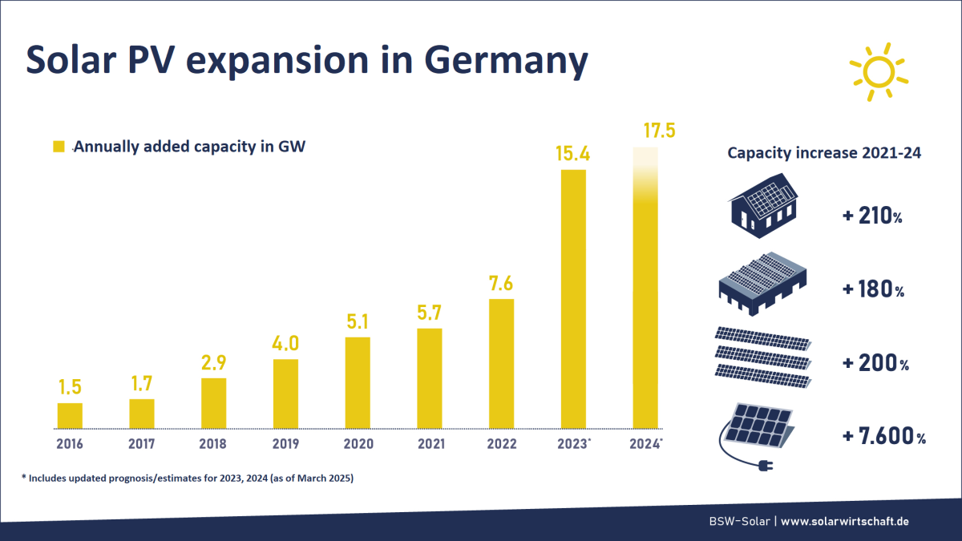
Renewable Energy Sources Act (Erneuerbare-Energien-Gesetz - EEG)
Goal: Rapid renewable expansion with priority grid access
Target: 80% of net gross electricity from renewables by 2030
Declining feed-in tariffs; rates drop every 6 months, fixed for 20 years once approved
  Compensation varies by system size and technology
As of 2023, must achieve 215 GW of solar by 2030
Reached an estimated total of 100 GW of solar as of 2025
Source: https://www.cleanenergywire.org/factsheets/solar-power-germany-output-business-perspectives

Slide 21
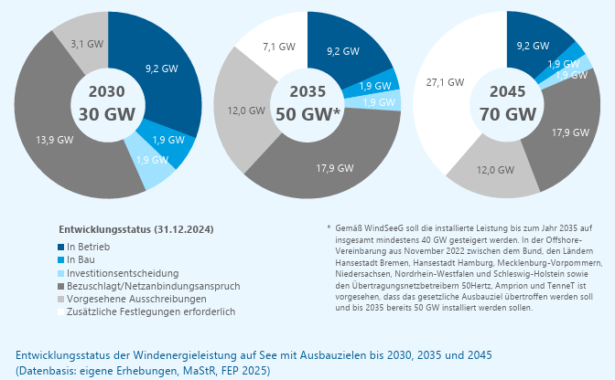
Offshore Wind Energy Act
(Windenergie-auf-See-Gesetz - WindSeeG)
Supports the development of offshore wind energy, with focus on environmental protection, on-shoring interconnection, and wind-turbine installation
Codifies the following installation goals:
  30 GW by 2030
  40 GW by 2035
  70 GW by 2045
9.2 GW already installed as of 2024
Source: https://www.wind-energie.de/fileadmin/redaktion/dokumente/publikationen-oeffentlich/themen/06-zahlen-und-fakten/20250204_Status_des_Offshore_Windenergieausbaus_Jahr_2024.pdf + https://www.wind-energie.de/fileadmin/redaktion/dokumente/publikationen-oeffentlich/themen/06-zahlen-und-fakten/20250204_Status_des_Offshore_Windenergieausbaus_Jahr_2024.pdf

Slide 22
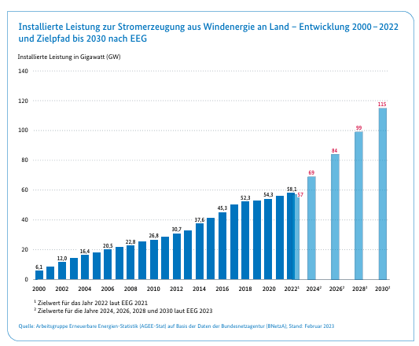
Onshore Wind Power Act
(Wind-an-Land-Gesetz - WaLG)
Enacts national onshore wind installation targets:
  1.4% of land allocated to wind by 2028
  2.0% of land allocated to wind by 2033
  Individual states have required goals to reach national targets
    Ranges from 0.25% to 2.2%
Disallows height limitations for new project sites
  Individual states are allowed to restrict wind projects through distance rules if their installation targets are met
Simplifies planning procedures and streamlines environmental protection reviews
Must achieve 115 GW by 2030 under EEG
As of mid-2025 has installed about 65 GW of onshore wind
Source: https://www.bundeswirtschaftsministerium.de/Redaktion/DE/Publikationen/Energie/windenergie-an-land-strategie.pdf?__blob=publicationFile&v=11
Notes:
Additional Source: https://stiftung-umweltenergierecht.de/wp-content/uploads/2022/07/Was-steckt-im-Osterpaket-WaLG-2022-07-21-1.pdf

Slide 23
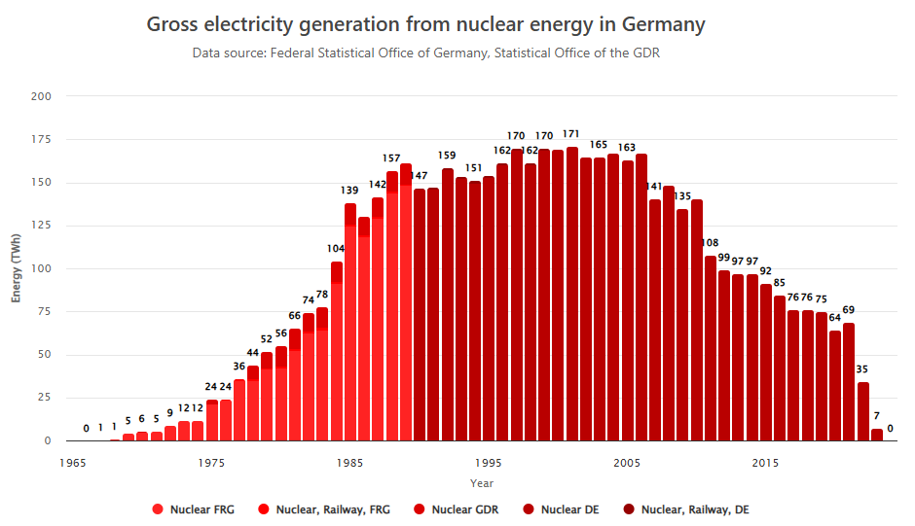
Atomic Energy Act (Atomgesetz - AtG)
Follow through with the codified phase out of domestic nuclear energy construction and operating reactors
  Initial phase-out was by end of 2022 in response to Fukushima
  Amended due to war in Ukraine to April 15, 2023
Source: https://energy-charts.info/charts/energy/chart.htm?l=en&c=DE&interval=year&year=-1&source=nuclear_1965-2024&legendItems=0w5

Slide 24
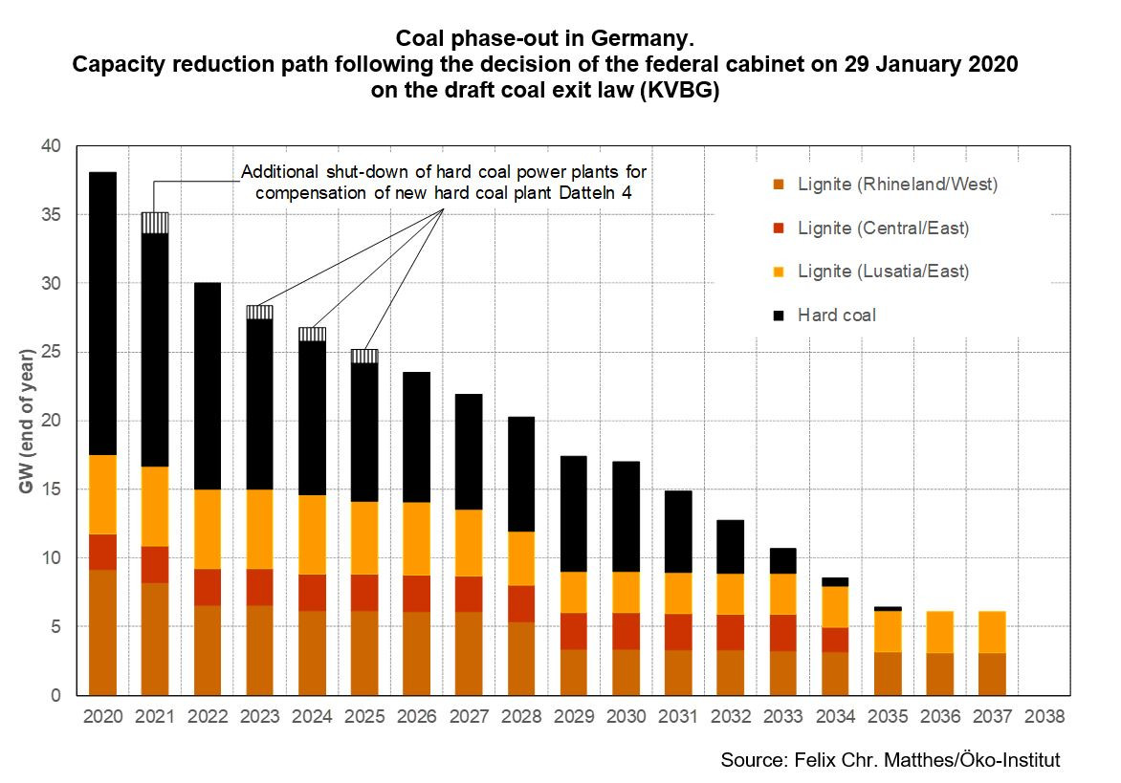
Coal Phase-out Act (Kohleausstiegsgesetz - KohleAusG)
Phase out of coal-fired power by end of 2038:
  Reduced to 15 GW of hard coal + 15 GW of lignite capacity in 2022
  Down to 8 GW of hard coal + 9 GW of lignite in 2030
  Earlier phase out by 2035 if determined in 2026, 2029 and 2032
Establishes a just transition for coal workers/miners/operators including:
  Plant operators may receive gradually reduced financial compensation for voluntary phase out by 2028
  Compensation for retiring workers
Source: https://www.cleanenergywire.org/factsheets/spelling-out-coal-phase-out-germanys-exit-law-draft

Slide 25
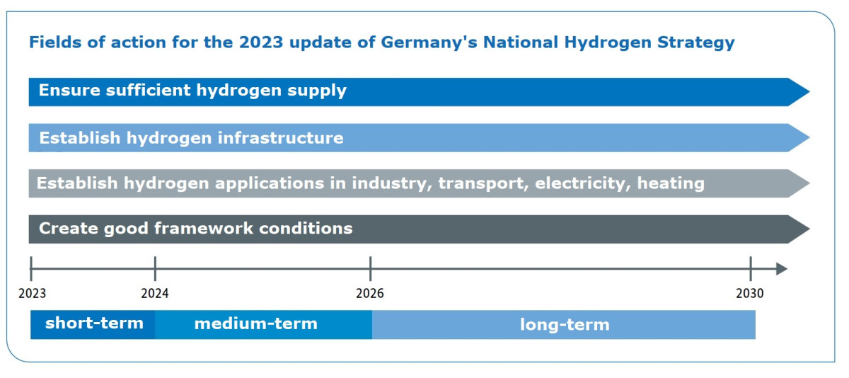
Hydrogen Strategy
(Nationale Wasserstoffstrategie)
Goal is to create a leading hydrogen market in Germany by 2030
Goal of at least 10 GW green hydrogen electrolyzer capacity
Financial support is limited to green hydrogen
1,800 km of hydrogen infrastructure to be built by 2027/2028
  Includes retrofitted natural gas pipelines
Will be used to power hard-to-abate sectors (e.g. industry, transportation, electricity, etc.)
Source: https://www.bundeswirtschaftsministerium.de/Redaktion/DE/Wasserstoff/Dossiers/wasserstoffstrategie.html

Slide 26
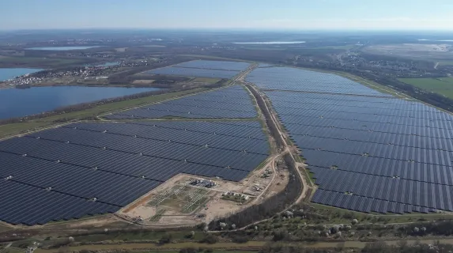
Renewable Energy Directive (RED) III Implementation
Creates acceleration zones nationwide for solar and wind projects, including co-located storage:
  Environmental and protected species studies can be skipped
  Permitting process shortened
  Less community opposition opportunities
Transitions permitting process to a digital process by Nov. 21, 2025
Witznitz Solar Farm with 605 MW capacity,
near Leipzig, Saxony (Sachsen)
Source: https://electrek.co/2024/04/12/germany-europe-largest-solar-farm/

Slide 27
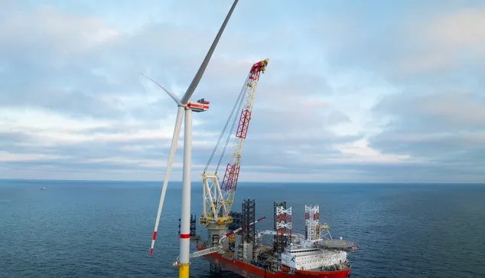
Climate and Transformation Fund Law
(Klima- und Transformationsfondsgesetz - KTFG)
Special funds authorized helping reach the nation’s climate and carbon neutrality goals
Additional $100 billion authorized over the next 12 years for:
  Investments in wind, solar, and hydrogen infrastructure
  Grid upgrades to integrate renewables
  Carbon capture and storage, nature-based solutions and resilience
  Part of $500 billion infrastructure and defense fund
First turbine installed for the EnBW He Dreiht Wind Farm – the largest offshore wind farm in Germany – with 960 MW capacity,
in the North Sea (April 2025)
Source: https://www.enbw.com/press/enbw-he-dreiht-offshore-wind-farm.html

Slide 28
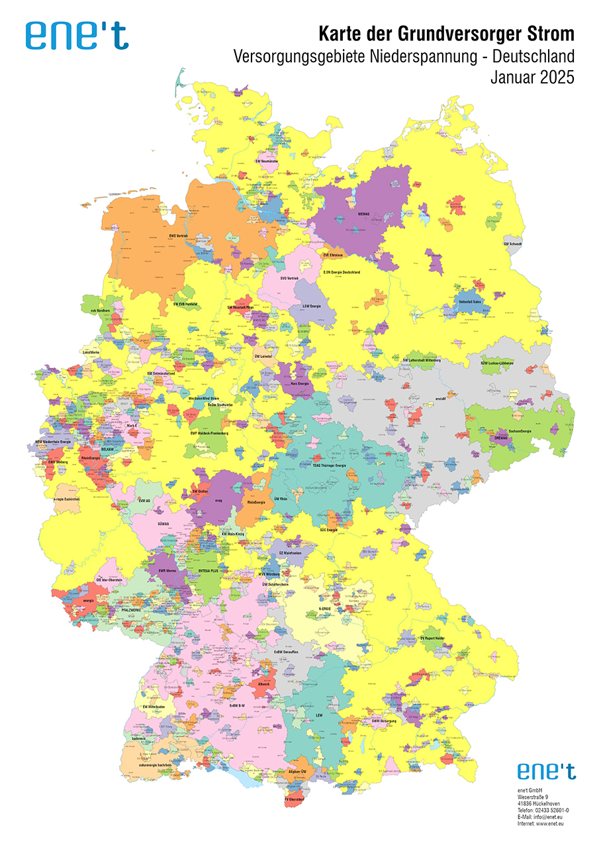
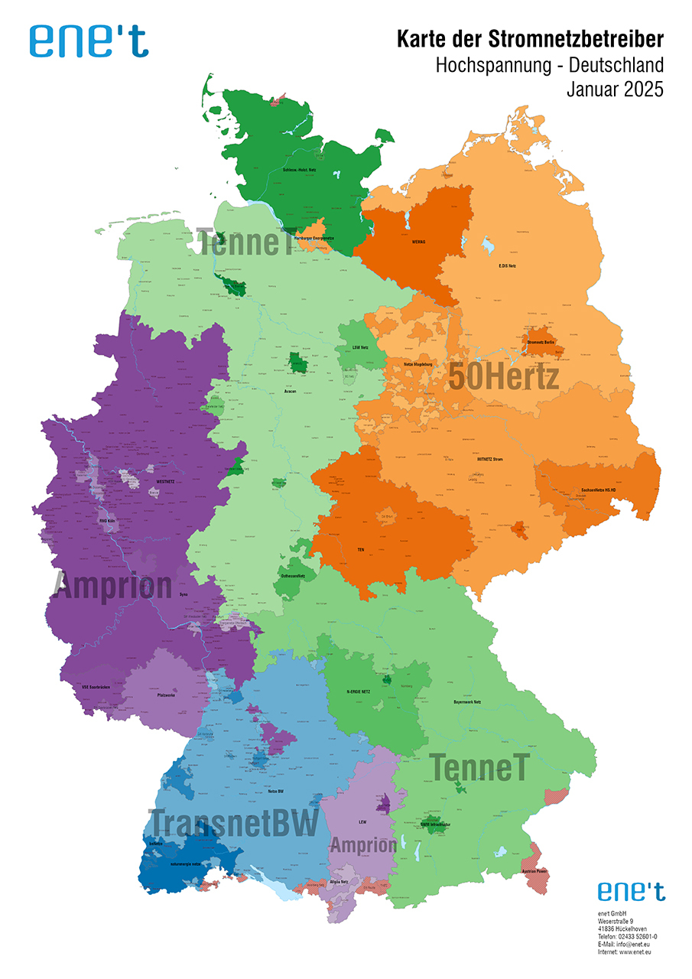
Electricity Market
Grid operators are separate from electricity providers
  4 grid operators
  900+ electricity providers
Lots of competition
  Free to choose your electricity provider
  Standard offer service if you don’t choose a provider
Source: https://www.enet.eu/portfolio/karten

Slide 29
United States

Slide 30
Emissions Reduction Policy
No national carbon reduction policy akin to Germany’s Climate Change Act
Various attempted GHG regulations through Environmental Protection Agency after a Supreme Court ruling in 2007
  Power Plants (e.g. Clean Power Plan)
  Vehicles (e.g. Tailpipe Emissions Rule)
  Have all been limited by courts or withdrawn by Trump administration

Slide 31
Clean Energy Policy
The Inflation Reduction Act of 2022 established or extended investment and production tax credits for renewable energy and energy storage
  One Big Beautiful Bill (2025) cut tax credits short for solar, wind, and hydrogen, and continued support for nuclear, geothermal, storage, and hydroelectric

Slide 32
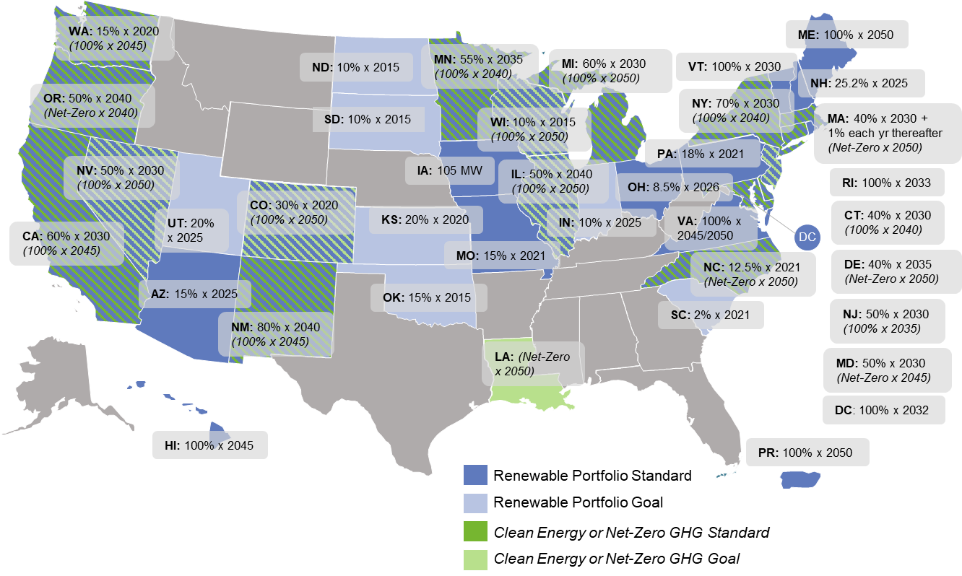
Renewable and Clean Energy Standards

Slide 33
Electricity Market
Electricity markets in the U.S. are, broadly, either regulated or deregulated
  Deregulated markets are like those in Germany, with electricity providers separate from grid operators
  Regulated markets have vertically-integrated monopoly utilities
Electricity markets are also divided into regional markets called RTOs or ISOs
  Make sure the grid is balanced and operators efficiently, oversee transmission
The Federal Energy Regulatory Commission governs RTO and ISO rules
  Exceptions apply; for example in Texas’ ERCOT, as it is all in one state

Slide 34
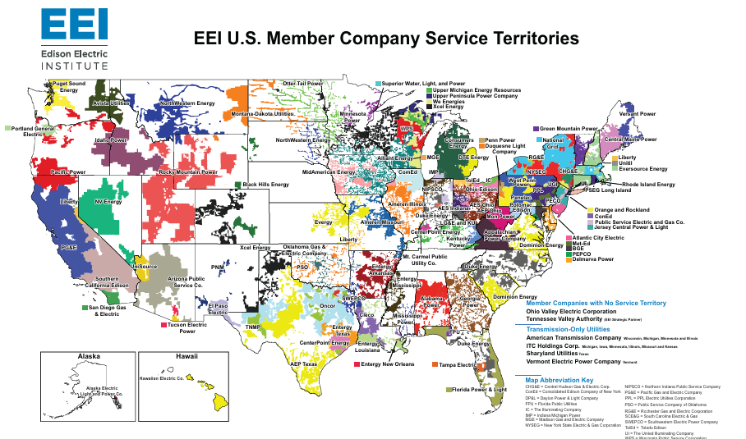

Slide 35
Southeastern U.S.

Slide 36
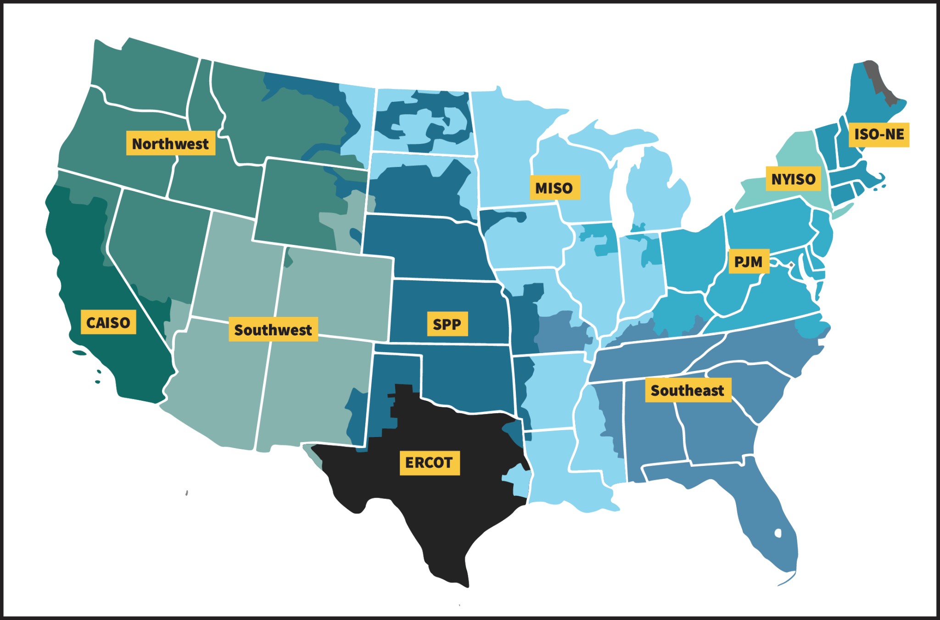
United States, Grid Operators

Slide 37
Southeastern United States
Southeast has a regulated/monopolistic market structure with electricity providers/utilities operating transmission
  Except for parts of Virginia, Kentucky, and North Carolina (i.e. PJM)
Virginia and North Carolina have renewable energy portfolio standards

Slide 38
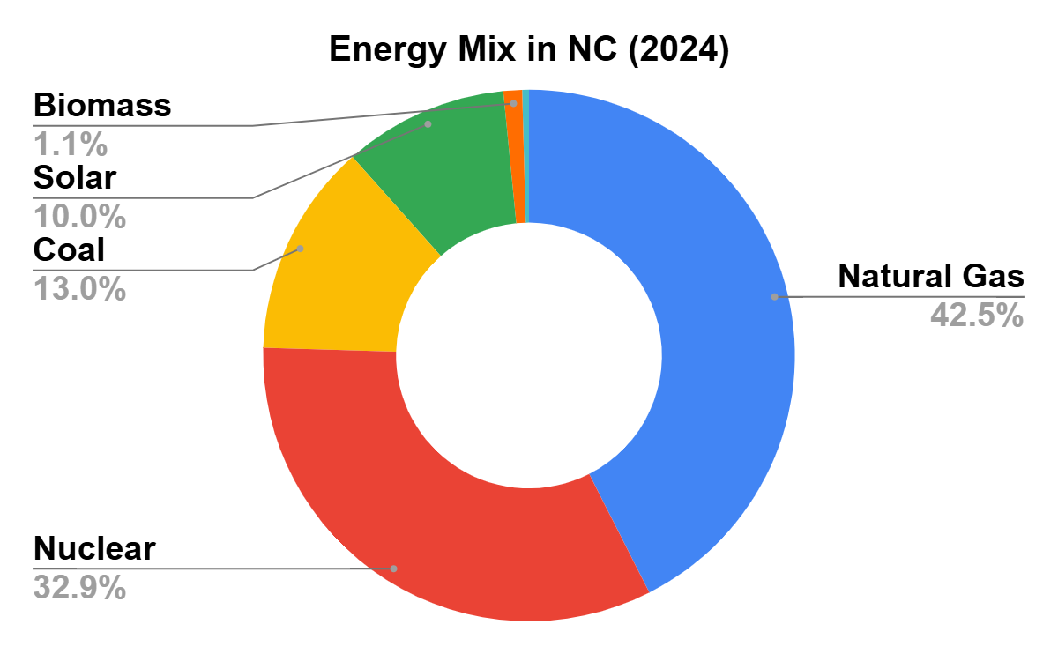
North Carolina
Nuclear, fusion, and renewable energy defined as clean energy
Power sector target: Carbon neutrality by 2050
Offshore wind goal:
8 GW installed capacity by 2040
Source: U.S. Energy Information Administration (EIA)

Slide 39
Breakout Session
1. Why do you think Germany and the United States have chosen such different paths when it comes to clean energy and emissions policy?
2. In what ways do you think people’s opinions influence clean energy policies in Germany versus the U.S.? Can you think of examples, like nuclear energy or support for renewables?
3. What other actions or changes do you think should happen to help reach clean energy goals and reduce emissions?

Slide 40






Contact us for more information
nccleantech@ncsu.edu | nccleantech.ncsu.edu
Follow us
@NCCleanTech
www.nccleantech.ncsu.edu

