Slide 1
Navigating the Advanced Nuclear Policy Landscape:
2025 So Far
Justin Lindemann, Senior Policy Analyst
NC Clean Energy Technology Center
Nuclear Advisory Council Q3 2025 Meeting
September 15th, 2025

Slide 2

Our Mission
The N.C. Clean Energy Technology Center, at N.C. State University, advances a sustainable energy economy by educating, demonstrating and providing support for clean energy technologies, practices, and policies.
For over 35 years, the Center has worked closely with partners in government, industry, academia and the non-profit community.

Slide 3
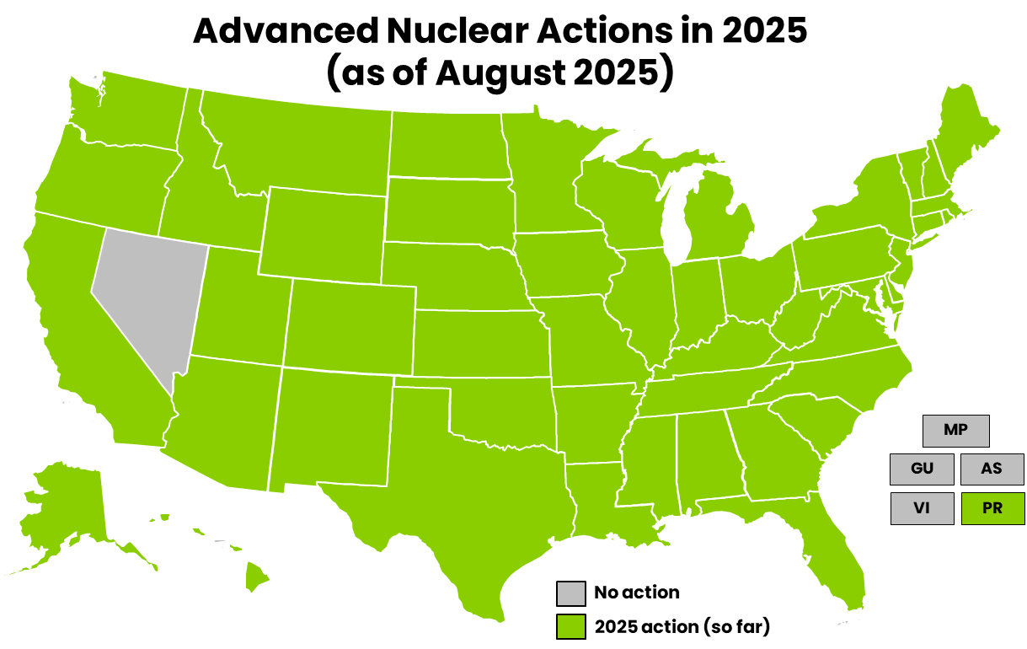
2025 Review of Advanced Nuclear Actions
Map (left) of 50 states and U.S. territories with legislative, executive, regulatory, and electric investor-owned utility (IOUs) actions in 2025 as of August related to advanced nuclear technologies.

Slide 4
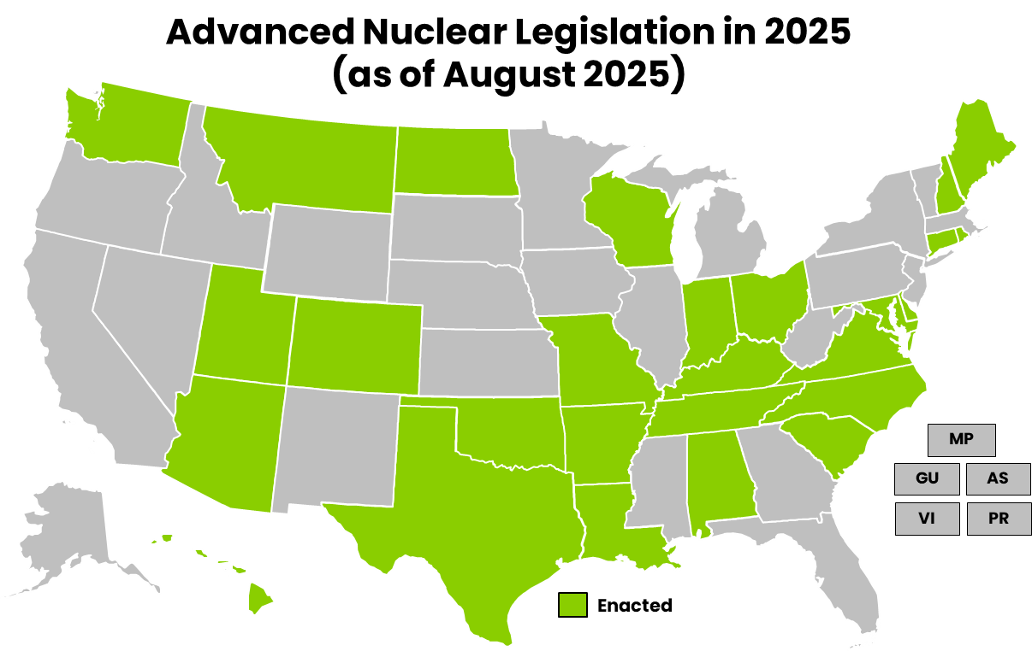
State Legislation
Map (left) of 27 states that enacted significant legislation in 2025 as of August, pertaining to advanced nuclear technologies.

Slide 5
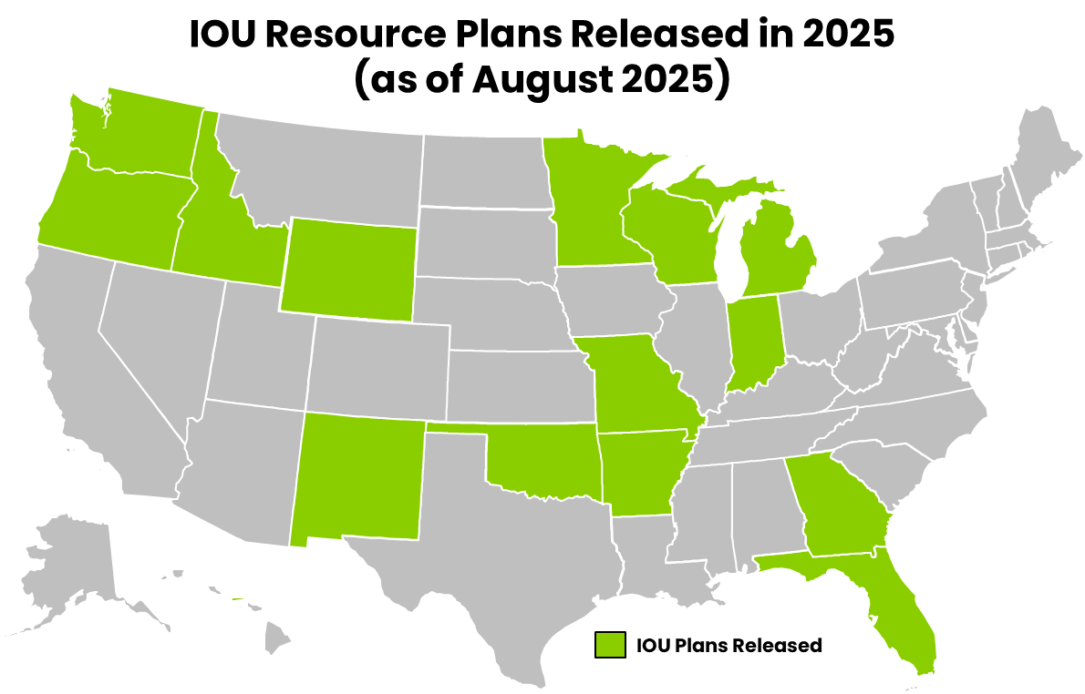
Utility Planning
Map (left) of an estimated 13 states where IOUs have filed draft and/or final resource plans in 2025 as of August, some including advanced nuclear technologies as a potential or deployable resource.
Notes:
*TVA’s IRP was expected spring/summer

Slide 6
Looking Forward
States moving from just studying nuclear feasibility to nuclear procurement, development, and deployment
Shifting away from moratoriums to exceptions and allowances
Viewing nuclear as a potential resource for combatting projected large load growth
Runway of incentives for early project development in addition to streamlined permitting
Recommissioning becoming a reality

Slide 7

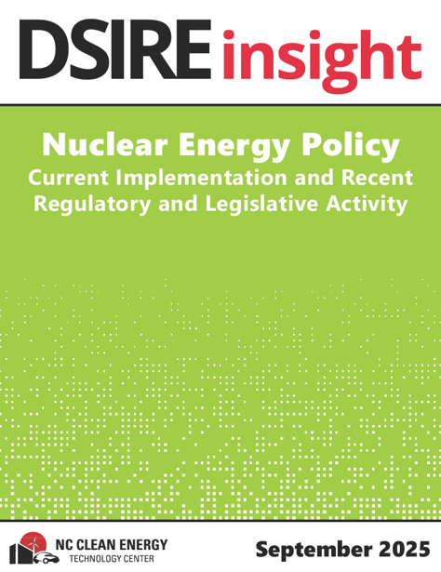
NCCETC is developing a Nuclear Energy Policy Data Sheet
DSIRE Insight policy research for energy industry professionals
Biannual tracking of state-by-state (incl. U.S. territories) nuclear policy:
Most recent legislative and regulatory actions
IOU nuclear resource planning updates
Relevant studies and reports
Federal and state incentives
Nuclear energy targets and moratoria
Important market announcements and actions
Release date: Fall 2025

Slide 8
Contact
Justin Lindemann, Senior Policy Analyst
NC Clean Energy Technology Center
jplindem@ncsu.edu
DSIRE Insight
dsire-admin@ncsu.edu

